Slide 1

GROCERY DELIVERY WEBSITE

Slide 2
GROCERY DELIVERY WEBSITE
A grocery delivery service is a platform through which groceries can be delivered to customers at their homes or a central pickup location. With grocery delivery services, you can place orders and make payments for various items online.
LMS Username | Name | Batch
2115a917 | DHARANI.R | A9
2115a923 | HARINI.B | A9
2115a926 | JANANI.G | A9
2115a927 | JANANI.G | A9

Slide 3
Main.html
<?xml version="1.0"encoding="utf-8"?>
<!DOCTYPE html PUBLIC"-//W3C//DTD XHTML 1.0 frameset//EN"
"http://www.w3.org/1999/xhtml">
<frameset rows="20%,80%">
<frame src="logo.html">
<frameset cols="30%,70%">
<frame src="menu.html">
<frame src="contents.html">
</frameset>
</frameset>
</html>

Slide 4
MENU.HTML
<html>
<head>
<title>
MENU
</title>
</head>
<body bgcolor=“skyblue”>
<center>
<nav>
<ul>
<h2><a href=“Login.html”/>Login</h2>
<h2><a href=“Fruit.html”/>Fruit</h2>
<h2><a href=“Vegetable.html”/>Vegetable</h2>
<h2><a href=“Daily Essential.html”/>Daily Essential</h2>
<h2><a href=“Fish & Meat.html”/>Fish & Meat</h2>
<h2><a href=“Home Care.html”/>Home Care</h2>
<h2><a href=“Packaged Food.html”/>Packaged Food</h2>
</ul>
</nav>
</center>
</body>
</html>

Slide 5
CONTENTS.HTML
<html>
<head>
<title>
content
</title>
</head>
<body>
<h3><img src="grocery.jpg"/>delivery</h3>
</body>
</html>

Slide 6
LOGO.HTML
<html>
<head>
<title>
LOGO
</title>
</head>
<body bgcolor="yellow">
<center>
<h1> HDJ GROCERY DELIVERY SERVICE</h1>
<h3>why cant't the groceries travel to you</h3>
</center>
</body>
</html>

Slide 7
LOGIN.HTML
<html>
<head>
<meta name="viewport" content="width=device-width, initial-scale=1">
<title> Login Page </title>
<style>
Body {
font-family: Calibri, Helvetica, sans-serif;
background-color: pink;
} button {
background-color: #4CAF50;
width: 100%;
color: orange;
padding: 15px;
margin: 10px 0px;
border: none;
cursor: pointer;
}

Slide 8
form {
border: 3px solid #f1f1f1;
}
input[type=text], input[type=password] {
width: 100%;
margin: 8px 0;
padding: 12px 20px;
display: inline-block;
border: 2px solid green;
box-sizing: border-box;
}
button:hover {
opacity: 0.7;
}
.cancelbtn {
width: auto;
padding: 10px 18px;
margin: 10px 5px;
} .container {
padding: 25px;
background-color: lightblue;

Slide 9
}
</style>
</head>
<body>
<center> <h1> Student Login Form </h1> </center>
<form>
<div class="container">
<label>Username : </label>
<input type="text" placeholder="Enter Username" name="username" required>
<label>Password : </label>
<input type="password" placeholder="Enter Password" name="password" required>
<button type="submit">Login</button>
<input type="checkbox" checked="checked"> Remember me
<button type="button" class="cancelbtn"> Cancel</button>
Forgot <a href="#"> password? </a>
</div>
</form>
</body>
</html>

Slide 10
FRUITS.HTML
<html>
<head>
<title>GROCERY WEBSITE</title> I
</head>
<body bgcolor="white">
<h2>APPLE</h2>
<img src="https://st3.depositphotos.com/29384342/34076/i/600/depositphotos_340760842-stock-photo-apple-isolated-white-background.jpg" alt="apple"/>
<h2>BANANA</h2>
<img src="https://media.istockphoto.com/id/1400057530/photo/bananas-isolated.jpg?b=1&s=170667a&w=0&k=20&c=uiSdjIQkTr7S4gEdW_oB_5zfFYhpfe0LP-CryQl49w4=" alt="banana"/>
<h2>GRAPES</h2>
<img src="https://cdn.pixabay.com/photo/2017/08/18/19/48/grapes-2656259__480.jpg" alt="grapes"/>
</body>
</html>

Slide 11
VEGETABLE.HTML
<html>
<head>
<title>VEGETABLES</title>
</head>
<body>
<h2>TOMATO</h2>
<img src="tomato.jpg"/>
<h2>CARROT</h2>
<img src="carrot.jpg"/>
<h2>CAULIFLOWER</h2>
<img src="cau.jpg"/>
</body>
</html>

Slide 12
DAILY ESSENTIAL.HTML
<html>
<head><title>GROCERY WEBSITE</title></head>
<body bgcolor="white">
<h2>MILK<h2>
<img src="https://images.hindustantimes.com/rf/image_size_630x354/HT/p2/2018/09/20/Pictures/_61433f0c-bcb9-11e8-95ec-91800d079bb4.jpg"alt="milk"/>
<h2>CURD<h2>
<img src="https://vrindavan.farm/images/portfolio/a1-curd-bg.jpg"alt="curd"/>
<h2>BUTTER<h2>
<img src="https://encrypted-tbn0.gstatic.com/images?q=tbn:ANd9GcQV8iAombS59_ZjFqgFI1jr5w6sW45qJE7YmA&usqp=CAU"alt="butter"/>
<h2>GHEE<h2>
<img src="https://www.bigbasket.com/media/uploads/p/xxl/20005456_4-organic-india-desi-ghee.jpg"alt="ghee"/>
</body></html>

Slide 13
FISH & MEAT.HTML
<html>
<head>
<title>fish and meat</title>
</head>
<body bgcolor="white">
<h2>FISH</h2>
<img src="https://encrypted-tbn0.gstatic.com/images?q=tbn:ANd9GcSRUIvcfEsTL_nn5DJiCAfJ6-8UwEhhXMH9cQ&usqp=CAU" alt="fish">
<h2>MEAT</h2>
<img src="meat.jpg"/>
<h2>EGG</h2>
<img src="egg.jpg"/>
</body>
</html>

Slide 14
HOMECARE.HTML
<html>
<head>
<title>HOME CARE</title>
</head>
<body bgcolor="white">
<h2>BRUSH<h2>
<img src="https://m.media-amazon.com/images/W/IMAGERENDERING_521856-T1/images/I/51hTIwQNGyL._SL1200_.jpg"alt="brush">
<h2>DETERGENT<h2>
<img src="https://5.imimg.com/data5/XC/XB/MY-8261133/4-1000x1000.png"alt="detergent">
<h2>SOAP<h2>
<img src="https://www.littlesoapcompany.co.uk/wp-content/uploads/2021/02/Avo_Lifestyle.jpg"alt="soap"
<h2>CLEANER<h2>
<img src="https://www.bigbasket.com/media/uploads/p/xxl/40206006-2_2-bb-home-disinfectant-floor-surface-cleaner-floral-kills-999-germs.jpg"alt="cleaner"/>
</body></html>

Slide 15
PACKAGED FOODS.HTML
<html>
<head>
<title>PACKAGED FOODS</title>
</head>
<body bgcolor=“white”>
<h2>PICKLED VEGGIES</h2>
<img src=“Pickled.jpg”alt=“pickle”/>
<h2>CHIPS</h2>
<img src=“chips.jpg”alt=“chips”/>
<h2>OATS</h2>
<img src=“oats.jpg”alt=“oats”/>
</body>
</html>

Slide 16
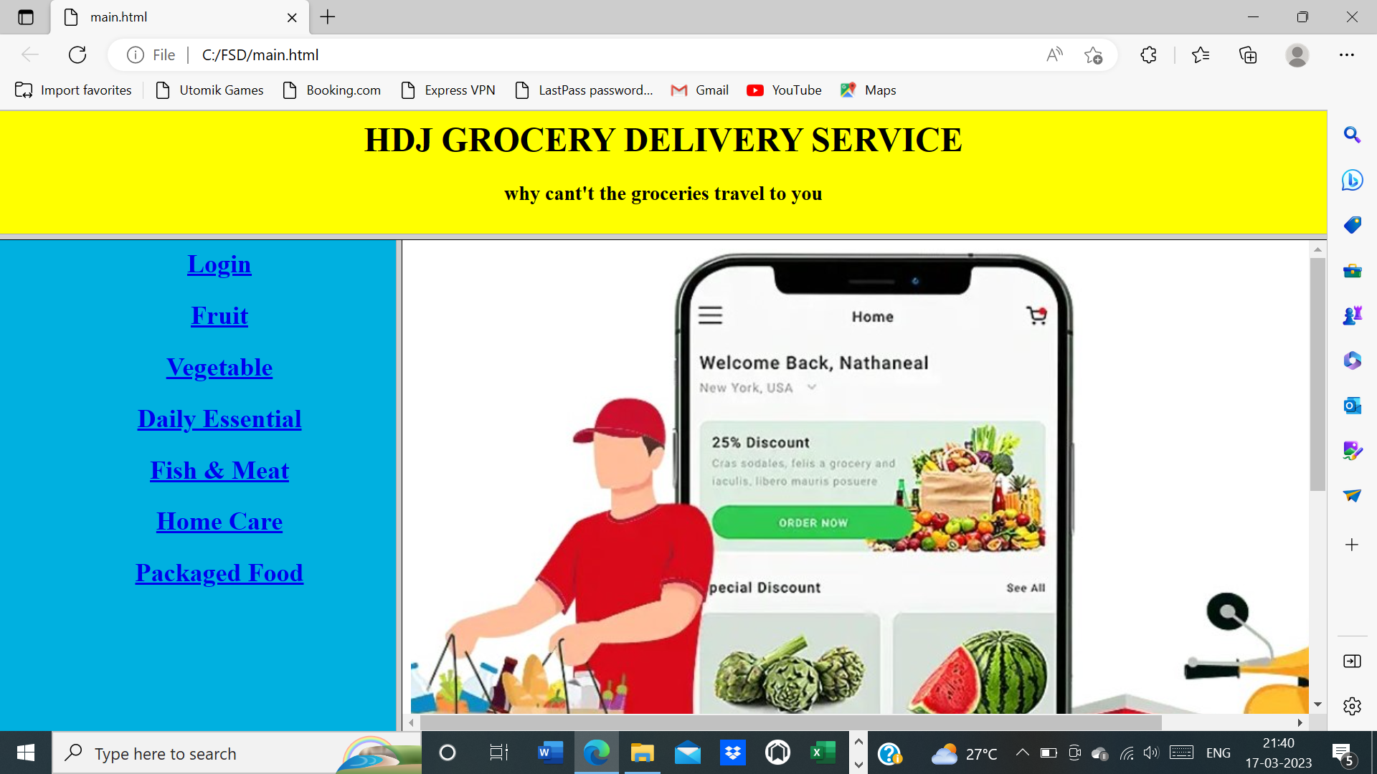

Slide 17
Submission Github
Grocery delivery website

